Slide 1
EXPLORING SUBMERGED HAZARDS: INNOVATION’s IN SUBMARINE ROCK AND MINE DETECTION RA2011026010082-SINDHU KALEESWARAN RA2011026010113-CHEREDDY SOWMYA SRI

Slide 2
TABLE OF CONTENTS:
Abstract
Introdution
Motivation
Innovation idea of the project
Scope of Project
Requirement Gathering
Literature Survey
Limitations Identified(from Literature)
References

Slide 3
Abstract:
This abstract highlights the significance of discriminating between these two underwater anomalies and explores the technological approaches employed in achieving accurate identification.
The detection and differentiation of submerged objects, such as submarine rocks and mines, play a pivotal role in maritime security and navigation safety.

Slide 4
Introduction: Submarine rocks, natural formations on the ocean floor, can sometimes exhibit characteristics that resemble underwater mines, which are deliberately placed explosive devices intended to target naval vessels. Accurate differentiation between these two types of underwater anomalies is critical for ensuring the safety of maritime activities, safeguarding naval assets, and maintaining navigational integrity.

Slide 5
Motivation:
The motivation for researching and developing techniques to differentiate between submarine rocks and underwater mines arises from the critical importance of maritime security, navigation safety, and the preservation of underwater ecosystems. It also promotes technological advancements that can have far-reaching impacts across military, navigational and environmental domains.

Slide 6
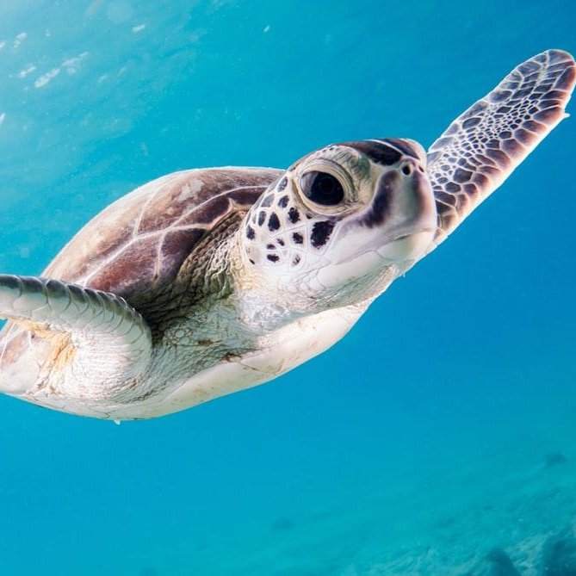
Innovation Idea:
Proposing an advanced approach for precise underwater differentiation between submarine rocks and mines by employing ensemble machine learning. Diverse underwater image data will be harnessed to train an ensemble of algorithms, comprising decision trees, random forests, support vector machines, and neural networks. The ensemble's collective decision-making will enhance detection accuracy by minimizing false identifications. This innovation ensures adaptability to varying underwater conditions through continuous learning.

Slide 7
Scope of Project:
By combining various ensemble methods and optimizing feature selection, these models can effectively handle complex relationships and class imbalances in the data. This approach enhances accuracy by aggregating diverse perspectives, allowing for real-time adaptation and scalability.
Integrating these ensemble models into existing underwater surveillance systems holds promise for enhancing maritime safety and environmental protection.

Slide 8
Requirements:
Functional Requirements:
The software requirements is the first step of an process.It lists the requirements of the particular software system.And these are some libraries used in this like sk-learn,pandas,Numpy,mat plot lib and sea born.Algorithms such as Logistic regression,KNN,
SVM,Naive Bayes,Decision tree,Random Forest,XGBoost.

Slide 9
Non-Functional Requirements:
Problem definition
Preparing data
Evaluating algorithms
Improving results
Prediction the result

Slide 10
Hardware Requirements:
Processor – i3 or higher
Hard Disk – 5 GB
Memory – 1GB RAM
Internet Connection
Software Requirements:
Windows 10 or higher
Colab – an online python interpreter
Python 3

Slide 11
Environmental Requirements:
OS - Windows, macOS, and Linux distributions GPU
Support Libraries and Frameworks
Documentation
Security
Scalability

Slide 12
Literature Survey:
S.No | Title | Techniques Discussed | Conclusion | Limitations
1 | “Machine Learning based Underwater Mine Detection”2023 7th ICICCS | One class of machine learning algorithms is XGBoost. Four varieties of machine learning algorithms are recognized. supervised, Unsupervised, Reinforcement, Semi Supervised. | This detection is done by a forecast model is built with the help of XGBoost algorithm, this forecast model yields more accuracy when contrasted with various classifier-based models because of its boosting nature. | XGBoost is a powerful algorithm, but it's often considered a "black box" model. It likely to have false predictions on mine detections. Moreover it doesnot check for cross-validation in case of over-fitting of data

Slide 13
2 | “Comprehensive Underwater Object Tracking Benchmark Dataset and Underwater Image Enhancement With GAN” IEEE JOURNAL OF OCEANIC ENGINEERING, JANUARY 2022 | An efficient GAN model is developed to improve the performance of existing trackers on distorted underwater data by efficiently translating the distorted data to their non-distorted/enhanced or clear underwater versions. | Analysis shows that correcting the underwater distortions by translating the visual data to an enhanced/clear domain using our model significantly improves tracking accuracy in underwater environments | The performance of state-of-the-art object tracking algorithms was shown to degrade considerably when tested on underwater environments as opposed to the open-air environments, due to the inherent distortions that affect the quality of Underwater Visual data.
3 | “Autonomous Underwater Environment Perceiving and Modeling: An Experimental Campaign With FeelHippo AUV for Forward Looking Sonar-Based Automatic Target Recognition and Data Association” IEEE JOURNAL OF OCEANIC ENGINEERING, APRIL 2023 | The SSD model has been trained using RMSProp with batch sizes of 24, whereas Mask R-CNN has exploited stochastic gradient descent with momentum with batch sizes of 1. | It is an extension of [18] and presents an experimental campaign concerning a CNN-based ATR and world modeling architecture for AUVs with FLS acoustical frames. | The outcome, with an average distance error of 0.73 meters, may not provide valid argument for the correctness.

Slide 14
4 | “Underwater object detection: architectures and algorithms – a comprehensive review”12 March 2022 | These aforementioned algorithms mainly employ CNN,YOLO and RCNN | Multiple subproblems in underwater object detection algorithms have also been comprehensively compared and reviewed. Also, deep learning-based underwater object detection algorithms, their architectures, and issues have been summarized. | However, not much of the work and research has been carried out in the area of underwater object detection using YOLO. These algorithms are not suitable for real-time underwater object detection.
5 | “Validation of Targets in Sonar Imagery Using Multispectral Analysis” IEEE JOURNAL OF OCEANIC ENGINEERING, OCTOBER 2022 | The JFT approach is based on the expected diversity in the reflection intensity of pixels associated with targets, compared to those associated with the background. In contrast, the JDRT method validates targets based on the difference in the distribution of pixels. | incorporation of the proposed validation approach within the sonar detection scheme yields a favorable tradeoff between the FAR and the detection rate. | Still, these experiments were not performed at sea, where the frequency-selective acoustic channel may distort the observa- tions.

Slide 15
6 | “Prediction of Rock and Mineral from Sound Navigation and Ranging Waves using Artificial Intelligence Techniques” Proceedings of the ICAISS-2022 | Simple Machine learning models from Logistic Regression to complex deep learning models such as LSTM and CNN models. | In this approach, PCA and t-SNE are employed to extract features. | It doesnot check for cross-validation in case of over-fitting of data.
7 | “Bathymetric Reconstruction From Sidescan Sonar With Deep Neural Networks” IEEE JOURNAL OF OCEANIC ENGINEERING,APRIL 2023 | CNN Architecture generates independent depth | A novel approach to reconstruct high-resolution bathymetry from sidescan data using a neural network is presented. | Several reasons could cause inaccurate sparse depth measurement like errors from the altimeter sensor, affecting the quality of reconstructed bathymetry. Not only the quality of the sparse depth but also the quantity affect the prediction accuracy.

Slide 16
8 | “Rock/ Mine Classification Using Supervised Machine Learning Algorithms” 2023 International Conference on IITCEE | Classification algorithm such as Light Gra- dient Boosting classifier, Random Forest classifier, and logistic to distin- guishing objects in submarine acoustics via resources sendSend message Checking who can access file | Among three algorithms, light gradient boosting achieves greater validation accuracy of 95%, logistic regression algorithm reaches less execution time of 0.015 seconds. | Could be better optimized for accurate results.
9 | “Side Scan Sonar Image Resolution and Automatic Object Detection, Classification and Identification” from IEEE Xplore | Probabilistic Neural Network (PNN) is used for final classification. As features for this classification process they use currently primarily some scoring values, which are generated by the false alarm reduction algorithms. | The results of the tests carried out with two algorithms for the reduction of false positives did not give totally different results for high resolution SAS and conventional SSS data. | Achieving high resolution and high area coverage simultaneously with a conventional SSS is rather difficult and a fundamental limitation of theses systems

Slide 17
10 | “Underwater Mine Detection and Classification in Sonar Imagery”2021 Journal of Mdpi | Deep convolutional neural networks were used to classify underwater targets in synthetic-aperture sonar (SAS) imagery. | Sonar images are complicated to analyse due to speckle noise and environmental conditions causing spurious shadows, sidelobe effects and multipath return. | Uses convolutional neural networks for location based on cross-validation. Manual setting of parameters is not required.
11 | “Prediction of Underwater Sonar Targets”July 2022 International Journal of Advanced Research in Computer and Communication Engineering | The Training Data trains the ML model (using different algorithms – LDA : Linear Discriminant analysis, SVM : Support Vector Machine, KNN : k-nearest neighbours, CART : Classification and Regression Trees, NB : Naive Bayes classifiers) and the Testing Data is used to evaluate the accuracy of the model | SVM model gives a better accuracy of approx. 93 % compared to the KNN model which gives approx. 88%. | The only dataset available for carrying out this project is not real world SONAR-data.

Slide 18
12 | “RDNN for classification and prediction of Rock/Mine in underwater acoustics” | SVM and NN algorithms were applied to distinguish sonar data.Utilized PCA and standalone architecture to integrate Back Propagation Neural Network for the categorization of two datasets (sonar and ionosphere datasets) in bagging ensemble architecture | Rock/mine detection neural network approach reveals enhanced outcomes by achieving mean accuracy of 100% with 0% SD using k-fold evaluation | RNNs require high-quality data for training. If the sonar data contains noise or artifacts, it can negatively impact the model's performance.
13 | “Classification of SONAR Targets Using Advanced Neural Classifiers”2017 International Journal of Pure and Applied Mathematics | Extreme learning machine is high speed learning neural network with single-hidden layer. ELM, the least square method is used for determining the output weight. | So efficiency of both networks is compared. The testing efficiency of MCNN and ELM are 87.5% and 84 % respectively. | MCNNs are highly data-dependent and prone to over-fitting and ELMs are not adaptive models. Therefore using these algorithms are not optimizable

Slide 19
14 | “Research on Classification and Recognition of Underwater Targets Based on Spark’s Decision Tree Technology” from IEEE Xplore | The decision tree algorithm uses the corresponding branching strategy from the top to the bottom to select the best branch attribute, and then divides the original data set according to the attribute. Spark also stores the intermediate data on the hard disk during MapReduce calculations. | This paper proposes a decision tree classification algorithm based on Spark. It makes good use of the memory-based distributed parallel processing capabilities of the Spark Big Data platform | All transformation operations are deferred, and they are not actuallyexecuted immediately. Only after the action operation iscompleted, it will actually trigger the previous transformationoperations.
15 | “Decision Tree-Based Adaptive Modulation for Underwater Acoustic Communications” from IEEE Xplore | A decision tree is trained to forecast the BER of the PSK signals based on estimates of channel delay and Doppler spread and the received SNR. | Results demonstrated that the decision tree predicted the BER fairly accurately. | Underwater channels are highly variable, influenced by factors like water temperature, salinity, and movement. This variability can make it challenging to adapt modulation schemes effectively in real-time.

Slide 20
16 | “A-KNN: An adaptive method for constructing high-resolution ocean models” from IEEE Xplore | This adopts the KNN regression method to refine the original dataset with a considerable interval, and the purpose is to interpolate the dataset into an evenly distributed dataset at intervals of 1 meter | The k-nearest neighbor regression model trained using the method proposed in this paper dramatically improves the vertical resolution of the data. | Due to the high cost of underwater nodes and related protective devices, wecannot solve the problem by increasing the amount of sparsity deployment of underwater nodes
17 | “Classification of Underwater Acoustic Signals Using Multi-Classifiers”Proceedings of 2018 15th International BCAST | K nearest neighbour,Support vector machine, Naïve Bayesian approach and artificial neural networks are used | Implemented multiple classification based identification techniques to classify underwater acoustic signals under controlled noise environment. The noise parameters for each type of classifiers were kept same. | some hybrid approaches can be deployed to getmore efficient results. Combination of Classifiers instead ofsingle one along with the denoising approach in preprocessingphase can provide much better results.

Slide 21
References:
1. D. P. Williams, “The Mondrian detection algorithm for sonar imagery,”IEEE Trans. Geosci. Remote Sens., vol. 56, no. 2, pp. 1091–1102,Feb. 2018.
2. Shantanu, Aman Saraf, Atharv Tiwari, Mukesh Kumar and S Manonmani, "Underwater Mines Detection using Neural Network", INTERNATIONAL JOURNAL OF ENGINEERING RESEARCH & TECHNOLOGY (IJERT), vol. 09, no. 04, April 2020 A 3. Review of Underwater Mine Detection and Classification in Sonar Imagery", Stanisław Hożyń ORCiD0000-0003-1422-0330.
4. S. Khaledi, H. Mann, J. Perkovich and S. Zayed, "Design of an underwater mine detection system", 2014 Systems and Information Engineering Design Symposium (SIEDS), pp. 78-83, 2014.
5. Guy Gubnitsky , Asaf Giladi, and Roee Diamant, “Validation of Targets in Sonar Imagery Using Multispectral Analysis”, IEEE JOURNAL OF OCEANIC ENGINEERING, VOL. 47, NO. 4, OCTOBER 2022

Slide 22
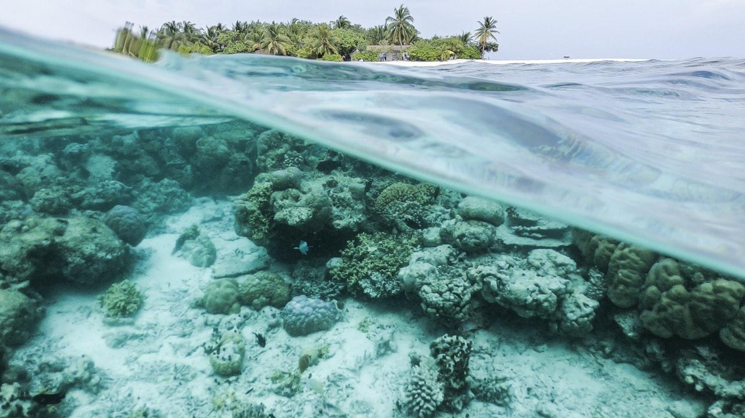
THANK YOU

